Slide 1
Lecture-3: Recurrent Problems (cont’d)
The Tower of Hanoi
Lines in the Plane
The Josephus Problem

Slide 2

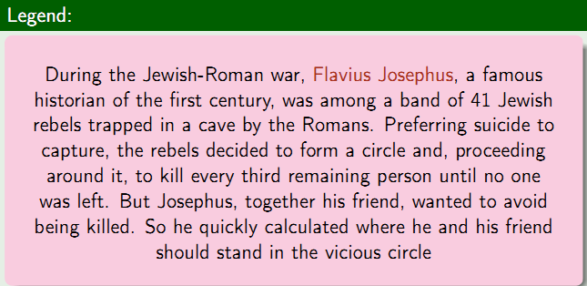

Slide 3



Slide 4
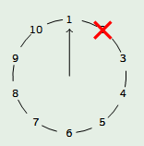
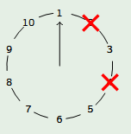
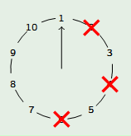
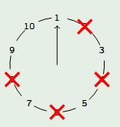
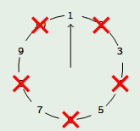
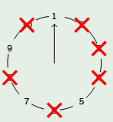
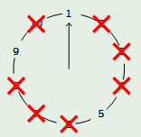
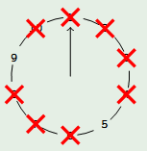
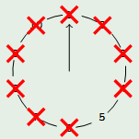
1
2
3
4
5
6
7
8
9

Slide 5

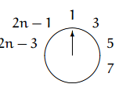

Assumptions
J(n) is always odd
So let's suppose that we have 2n (even) people originally. After the first go round, we're left with
Remains,

Slide 6

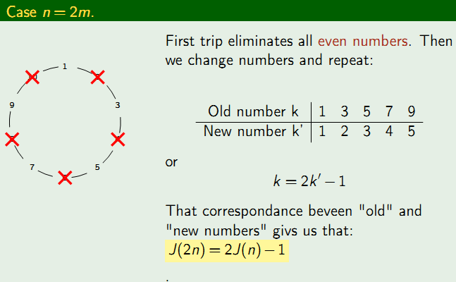

Slide 7
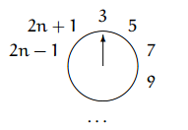

Assumptions (cont’d)
But what about the odd case?
With 2n + 1 people, it turns out that person number 1 is wiped out just after person number 2n, and we're left with
Remains,

Slide 8

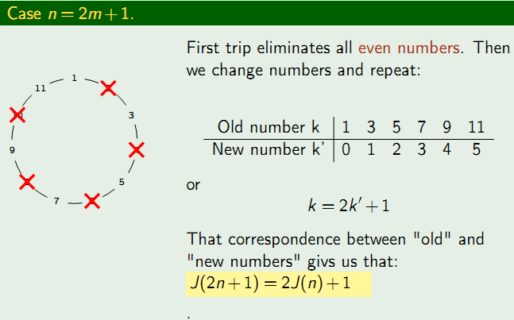

Slide 9

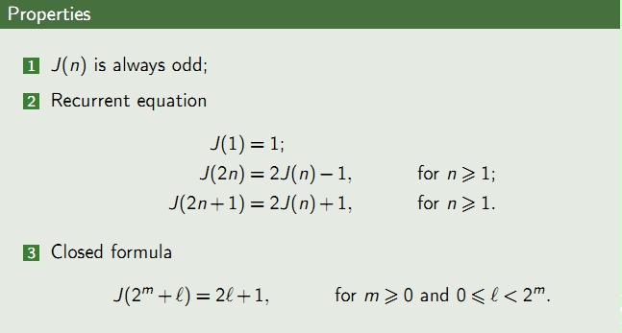

Slide 10
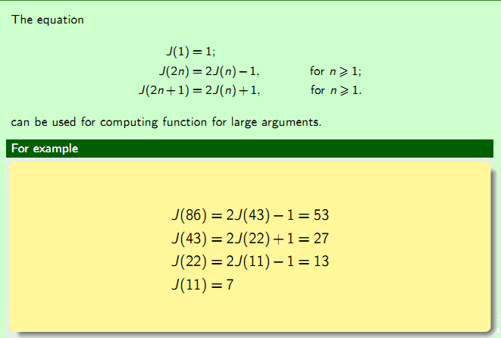

Slide 11
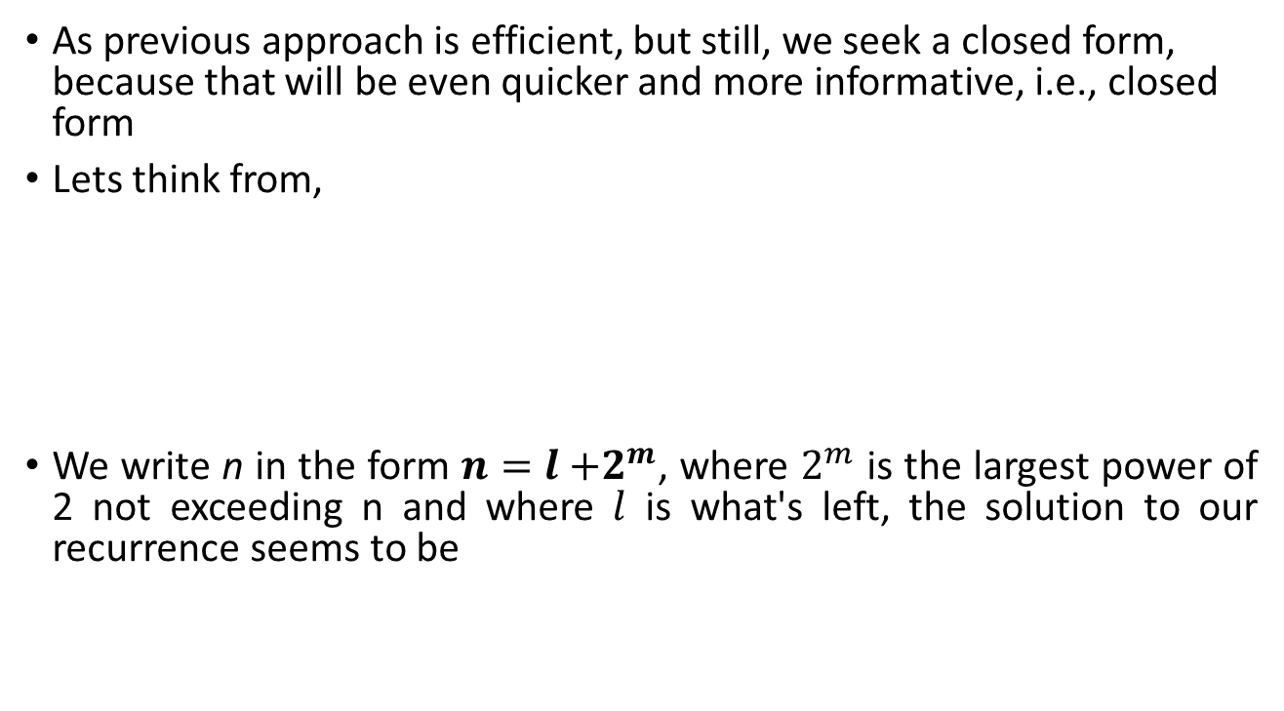

Finding closed form

Slide 12

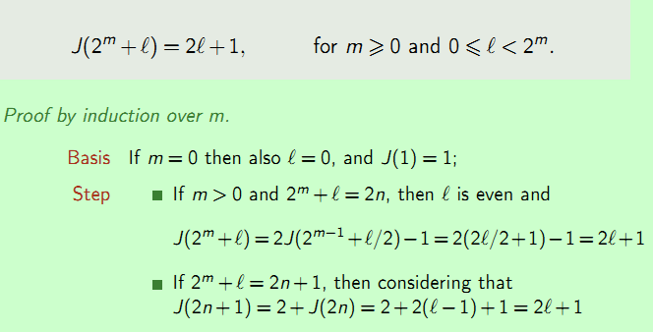
Notes:
2+J(2n)=2+J(2^m+l-1)=2+2 (l-1)+1=2l+1

Slide 13


Slide 14

